Slide 1
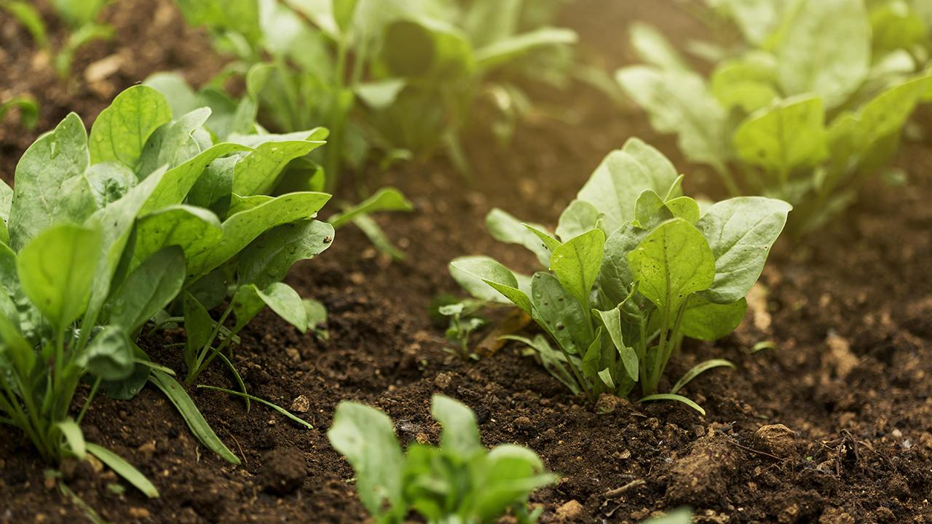
SMARTFARMER - IOT ENABLED SMART FARMING APPLICATION
TEAM MEMBERS:
REVILLA JYOSTHNA
K. PANNAVE
R. PRITHA
S. IYSWARYA

Slide 2
POWER SUPPLY
SOIL MOISTURE SENSOR
NODEMCU
RELAY COIL
AC MOTOR PUMP
TEMPERATURE AND HUMIDITY SENSOR (DHT11)
BUZZER
IBM WATSON
NODERED
WEB UI
MIT APP
USER

